Slide 1
APOLOGETICS
IN ONE LESSON
almost
Ai1L.net
Lesson 5
Is the New Testament from Eyewitnesses?

Slide 2
Key Takeaways (review)
1
Remember that you are a foreigner spreading the Gospel in a foreign land (the United States)
2
Look for areas of agreement before looking for areas of disagreement
3
Build a case for the Gospel starting with the areas of agreement

Slide 3
183
307
Questions Jesus
Questions Jesus
Answered
Asked

Slide 4
“If I have only an hour with someone, I will spend the first 55 minutes asking questions and finding out what is troubling their heart and mind, and then in the last 5 minutes I will share something of the truth.”
FRANCIS SCHAEFFER

Slide 5

Simon of Cyrene, father of Rufus
1
Mark was written in Rome
Rufus is possibly associated with Rome
2
Mark names Rufus in Mark 15:21
3
Paul acknowledges a Rufus in Romans 16:13
Rufus was named in Mark because he was known to the people in Rome

Slide 6
Sources in the Gospel of Mark
Peter flees (14:72)
Two women named¹ (15:47)
Angel says to get Peter (16:7)
Peter’s perspective
Peter’s perspective
Women’s perspective
Three women named² (16:1)
Jesus criticizes the men for not believing (16:14)
Simon of Cyrene (15:21)
¹ | Mary Magdalene Mary, mother of Joseph
² | Mary Magdalene Mary, mother of James Salome

Slide 8
IDEA IN BRIEF
What?
Show that the Gospel accounts come from eyewitness testimony
Why?
So that we can show that the Gospels did not form via legendary development
How?
By showing that:
Gospels are ancient biographies which expected living eyewitnesses
The New Testament & early church valued and named living eyewitness sources

Slide 9
Read the requirements for the 12 Apostles
1

Slide 10
“the events had hardly passed out of sight, conscious as I was that I had preserved the true story”
FLAVIUS JOSEPHUS The Life of Flavius Josephus, 361

Slide 11
“I, on the contrary, have written a veracious account, at once comprehensive and detailed, of the war, having been present in person at all the events.”
FLAVIUS JOSEPHUS Against Apion, 1.9

Slide 12
“where some persons have written histories, and published them, without having been in the places concerned, …”
FLAVIUS JOSEPHUS Against Apion, 1.8

Slide 13
“… but these men put a few things together by hearsay, and insolently abuse the world, and call these writings by the name of Histories.”
FLAVIUS JOSEPHUS Against Apion, 1.8

Slide 14
Document the claims that Luke makes in regards to his sources
2

Slide 15
Heirapolis
Home of Papias

Slide 16
“For I did not think that information from the books would profit me as much as information from a living and surviving voice.”
PAPIAS OF HIERAPOLIS Ecclesiastical History 3.39.3-4 Writing ~110 CE of an earlier period (~80 CE)

Slide 17
“I shall not hesitate also to put into ordered form for you, along with the interpretations, everything I learned carefully in the past from the elders and noted down carefully, for the truth of which I vouch.”
PAPIAS OF HIERAPOLIS Ecclesiastical History 3.39.3-4 Writing ~110 CE of an earlier period (~80 CE)

Slide 18
“For unlike most people I took no pleasure in those who told many different stories, but only in those who taught the truth.”
PAPIAS OF HIERAPOLIS Ecclesiastical History 3.39.3-4 Writing ~110 CE of an earlier period (~80 CE)

Slide 19
“Nor did I take pleasure in those who reported their memory of someone else’s commandments …”
PAPIAS OF HIERAPOLIS Ecclesiastical History 3.39.3-4 Writing ~110 CE of an earlier period (~80 CE)

Slide 20
“…but only in those who reported their memory of the commandments given by the Lord to the faith and proceeding from the Truth itself.”
PAPIAS OF HIERAPOLIS Ecclesiastical History 3.39.3-4 Writing ~110 CE of an earlier period (~80 CE)

Slide 21
“And if by chance anyone who had been in attendance on the elders arrived, I made enquiries about the words of the elders—…”
PAPIAS OF HIERAPOLIS Ecclesiastical History 3.39.3-4 Writing ~110 CE of an earlier period (~80 CE)

Slide 22
“… what Andrew or Peter had said, or Philip or Thomas or James or John or Matthew or any other of the Lord’s disciples, and whatever Aristion and John the Elder, the Lord’s disciples, were saying.”
PAPIAS OF HIERAPOLIS Ecclesiastical History 3.39.3-4 Writing ~110 CE of an earlier period (~80 CE)

Slide 23
“For I did not think that information from the books would profit me as much as information from a living and surviving voice.”
PAPIAS OF HIERAPOLIS Ecclesiastical History 3.39.3-4 Writing ~110 CE of an earlier period (~80 CE)

Slide 24
Chain of Custody
Jesus
John
Papias
Polycarp
Irenaeus

Slide 25
“But now when these men are no longer with us, and you think you cannot be contradicted, you venture to publish it.”
FLAVIUS JOSEPHUS The Life of Flavius Josephus, 336

Slide 26
“﻿gathering information out of a book is not the same thing, nor even comparable to learning from the living voice.”
GALEN ﻿De Compositione Medicamentorum Secundum Locus, 6

Slide 27
“﻿better to be an eyewitness¹ by the side of the master himself and not to be like those who navigate out of books.”
GALEN ﻿De Temperamentis, 6
¹ Same word that Luke uses (αὐτόπτης)

Slide 28
“﻿﻿As to the facts themselves, [the historian] should not assemble them at random, but only after much laborious and painstaking investigation”
LUCIAN OF SAMISOTA ﻿Quomodo historia conscribenda sit, 47

Slide 29
“﻿He should for preference be an eyewitness but, if not, listen to those who tell the more impartial story”
LUCIAN OF SAMISOTA ﻿Quomodo historia conscribenda sit, 47

Slide 30
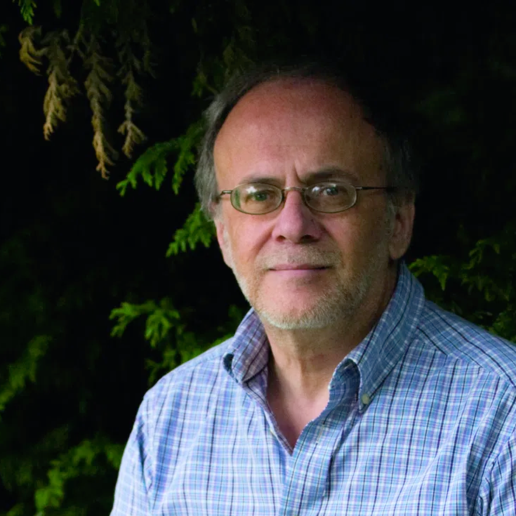
“﻿Papias assumes that the value of oral traditions depends on their derivation from still living witnesses”
RICHARD BAUCKHAM ﻿Jesus and the Eyewitnesses (page 28)

Slide 31
Document the claims of 1 Corinthians 15:1-8 regarding the resurrection account sources
3

Slide 32
“those who were healed … were always present,
not merely when the Savior … some of them survived even to our own times”
QUADRATUS OF ATHENS Ecclesiastical History 4.3.2 Writing in 117 CE

Slide 33
Healing Beneficiaries
Beneficiary | Mark | Matthew | Luke
Jairus
Bartimaeus
… son of Timaeus
5:22
9:18
(unnamed)
8:41
10:46
20:30 (unnamed)
18:35 (unnamed)
10:46

Slide 34
Number of Names
Count of names in the same story told in multiple accounts (excluding major characters and famous people)

Slide 35
Document how the Twelve defended the resurrection
4

Slide 36
Key Takeaways
1
Gospels are ancient biographies which expected living eyewitnesses
2
The New Testament valued living eyewitness sources (and named them)
3
The early church valued living eyewitness sources (and could name them)

